Slide 1
AssociaTions Managing the Impedance mismatch
Notes:
http://www.thoughts-on-java.org/jpa-21-overview/

Slide 2
ORM Impedance Mismatch
2 Different Technologies – 2 different ways to operate
EXAMPLE
OO traverse objects through relationships
Category category = product.getCategory();
RDB join the data rows of tables
SELECT c.* FROM product p,category c where p.category_id = c.id;
OTHERS:
Many-to-many relationships
Inheritance
Collections
Identity [Primary Key .vs. a.equals(b)]
Foreign Keys
Bidirectional [“Set both sides”]
Granularity [# of Tables .vs. # of Classes]
Notes:
https://www.javaworld.com/article/2074996/hashcode-and-equals-method-in-java-object---a-pragmatic-concept.html
"==" operator will return true only if two object reference it is comparing represent exactly same object otherwise "==" will return false.

Slide 3
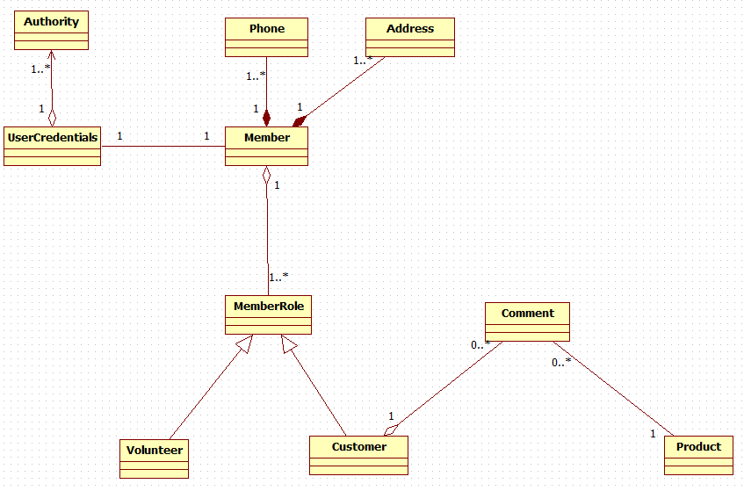
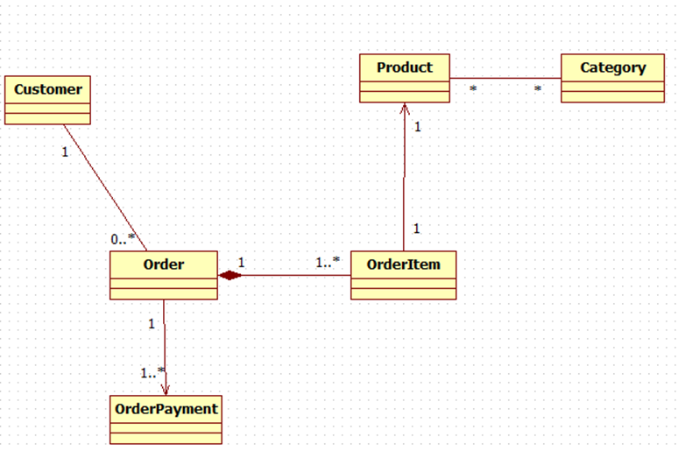
Target Application
Design Model

Slide 4
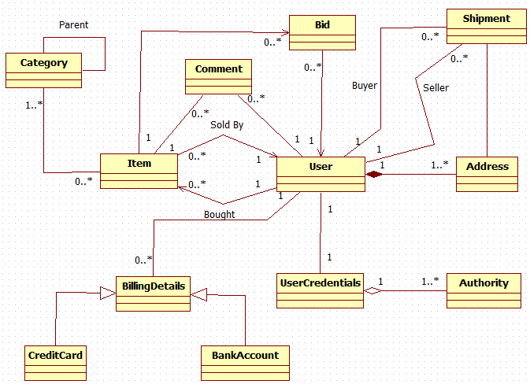
Hibernate Caveat Emptor
Student Target Application Design Model
[Latin, Let the buyer beware!]
A warning that notifies a buyer that the goods he or she is buying are "as is," or subject to all defects.

Slide 5
Member Entity
Example
@Entity
public class Member {
@Id
@GeneratedValue(strategy=GenerationType.AUTO)
@Column(name="member_id")
private Long id;
@Column(length = 16)
private String firstName;
@Column(length = 16)
private String lastName;
...
@OneToOne(fetch=FetchType.LAZY, cascade = CascadeType.ALL)
@JoinColumn(name="username")
UserCredentials userCredentials;
@OneToMany(mappedBy="member",fetch=FetchType.LAZY,
cascade={CascadeType.PERSIST, CascadeType.MERGE })
private Set<Address> addresses = new HashSet<Address>();

Slide 6
Configurable Parent-Child operations JPA Cascade Types
PERSIST
Cascading calls to EntityManager.persist() - persists children.
MERGE
Cascading calls to EntityManager.merge() - updates children.
REMOVE
Cascading calls to EntityManager.remove() - deletes children.
REFRESH
Cascading calls to EntityManager.refresh() – refreshes children
ALL
Shortcut for cascade={PERSIST, MERGE, REMOVE, REFRESH}
Example:
@OneToMany(cascade = CascadeType.PERSIST)
If orphanRemoval=true then a disconnected child is automatically removed.
e.g., userCredentials.getAuthority.remove(0);
userCredentialsDao.update(userCredentials);
Use: Composition relationship[Child does NOT exist without Parent relationship]
see OneToManyUniCol Demo
Notes:
delete-orphan [Hibernate]
-
Cascade into a collection (normal delete doesn’t)
Orphanremoval [JPA]
http://stackoverflow.com/questions/4329577/jpa-2-0-orphanremoval-true-vs-on-delete-cascade
@OneToOne(orphanRemoval=true)
The difference between the two settings is in the response to disconnecting a relationship. For example, such as when setting the address field to null or to another Address object.
If orphanRemoval=true is specified the disconnected Address instance is automatically removed. This is useful for cleaning up dependent objects (e.g. Address) that should not exist without a reference from an owner object (e.g. Employee).
If only cascade=CascadeType.REMOVE is specified, no automatic action is taken since disconnecting a relationship is not a remove operation.

Slide 7
Configurable Parent-Child operations
Fetching Strategies
Immediate fetching: an association, collection or attribute is fetched immediately when the owner is loaded.
[(JPA)Default for one-to-one]
@OneToOne(fetch=FetchType.EAGER)
Lazy collection fetching: a collection is fetched when the application invokes an operation upon that collection.
[Default for collections]
@OneToMany(fetch=FetchType.LAZY)
Notes:
@LazyCollection - HIBERNATE
"Extra-lazy" collection fetching: individual elements of the collection are accessed from the database as needed. Hibernate tries not to fetch the whole collection into memory unless absolutely needed. It is suitable for large collections.
As of release 3.2, Hibernate can perform per-item lazy initialization of collections. The reference documentation mentions it here. When the association mapping (OneToMany or ManyToMany) is set to lazy="extra", the collection implementation for the mapping takes on "smart" collection behavior, i.e. some collection operations such as size(), contains(), get(), etc. do not trigger collection initialization. This is only sensible for very large collections, but it's quite handy nonetheless.
https://stackoverflow.com/questions/8077385/hibernate-extra-lazy-dangerous
https://frightanic.com/software-development/extra-lazy-one-to-many-mapping-with-hibernate/

Slide 8
Configurable Parent-Child operations
Fetch - Cascade Example
public class Member{
@OneToMany(mappedBy="member",fetch=FetchType.LAZY,
cascade={CascadeType.PERSIST, CascadeType.MERGE })
private Set<Address> addresses = new HashSet<Address>();
FetchType.LAZY means collection is NOT fetched until collection element is referenced…
It also means that you will get a LazyInitializationException
If you try to reference it after the PersistenceContext is closed!!
CascadeType[s] means collection is persisted or merged when parent is.

Slide 9
Main Point
A good ORM provides features that allow the developer to easily traverse object relationships.
Science of Consciousness: When we practice the TM Technique, we tap an inner reserve of energy and intelligence that allows us to easily and flexibly manage the diverse activities of every day life

Slide 10
OrganizingTest Data
Object Mother
Set of factory methods that create test data objects
Customer customer = CreateTestCustomer();
Becomes
Customer customer = CustomerObjectMother.CreateCustomer();
Issue
Customer customer = CustomerObjectMother.CreateWashingtonBasedCustomer();
Versus
Customer customer = CustomerObjectMother.CreateCustomer();
customer.setState(“WA”);
Names could become Long & Ambiguous depending on the number of variables
More data clarity at test level:
Can see test data inline

Slide 11
Organizing Test Data
Test Data Builder
Based on Builder Pattern
[Solution to the telescoping constructor anti-pattern]
[Also explicitly shows the data that affect the outcome of the test]
Reduces the number of constructors, by processing initialization parameters step by step
Customer customer = new CustomerBuilder()
.withState(“WA”)
.withZipCode(“98765”)
.withFirstName(“Fred”)
.build();
….We’ll use this pattern for our Association Demos….
Notes:
DEMO REPOSITORY MOCK ..SA Version
telescoping constructor :
public FoodTelescopingDemo(int id, String name) {
this(id, name, 0, 0, 0, "default description");
}
public FoodTelescopingDemo(int id, String name, int calories) {
this(id, name, calories, 0, 0, "default description");
}
public FoodTelescopingDemo(int id, String name, int calories, int servingSize) {
this(id, name, calories, servingSize, 0, "default description");
}
public FoodTelescopingDemo(int id, String name, int calories, int servingSize, int fat) {
this(id, name, calories, servingSize, fat, "default description");
}

Slide 12
Telescoping Constructors
public Product(Long id, String name) {
this(id,name,””, 0.0,null);
}
public Product(Long id, String name, String Description) {
this(id,name,description, 0.0,null);
}
public Product(Long id, String name, String Description,Float price) {
this(id,name,description, price,null);
}
public Product(Long id, String name, String Description,Float price,Category category) {
this.setId(id);
this.setName(name);
…
}
Difficult to identify parameters of the same type
Often there isn't a constructor that fits your need
So, either add a new constructor or use a null parameter.

Slide 13
Spring Testing Support
Testing is an integral part of enterprise software development.
Use of IoC makes unit and integration testing easier
Spring provides first-class support for integration testing
SpringJUnit4ClassRunner provides the functionality of the Spring TestContext Framework:
Consistent loading & caching of Spring ApplicationContexts
Creation and roll back of transactions for each test
@ContextConfiguration declares the application context resource locations[XML] or the annotated classes[JavaConfig] that will be used to load the context for integration tests
Spring Testing
See OneToOneUni Junit Test
Notes:
NO @TRANSACTIOAL in UNIT TEST:
In InnoDB , all user activity occurs inside a transaction. ... If autocommit mode is disabled within a session with SET autocommit = 0 , the session always has a transaction open. A COMMIT or ROLLBACK statement ends the current transaction and a new one starts.

Slide 14
ORM Parent-Child “Relationships”
One-to-One
One-to-Many/Many-to-One
Many-to-Many
Unidirectional – Bidirectional
Inheritance

Slide 15

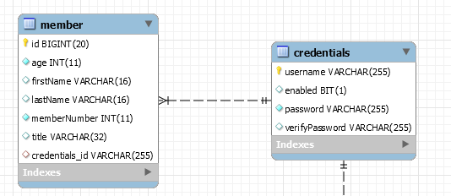
OneToOne Unidirectional
Member.Java
@OneToOne(fetch=FetchType.LAZY, cascade={CascadeType.PERSIST,CascadeType.REMOVE})
@JoinColumn(name=“credentials_id")
private UserCredentials userCredentials;
DEMO OneToOneUni
Notes:
implement a one-to-one association in a database:
One-to-one with foreign key relationship
the hibernate way to map this[one-to-one] is to use a many-to-one association (that allows to specify the foreign key).
The reason is simple: You don’t care what’s on the target side of the association, so you can treat it like a to-one association without the many part. All you want is to express “This entity has a property that is a reference to an instance of another entity” and use a foreign key field to represent that relationship.
Shared foreign key:
@Id
@OneToOne
@JoinColumn(name = "book_id")
private Book book;

Slide 16
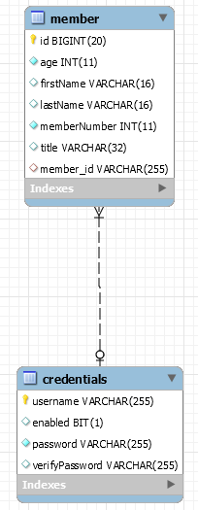
OneToOne Bi-directional
Annotate the OTHER side of the relationship ALSO…
@Entity
public class UserCredentials {
@Id
private long id; ...
@OneToOne(mappedBy="userCredentials",cascade=CascadeType.PERSIST)
private Member member;
}
DEMO OneToOneBI
mappedBy – Is used in a bidirectional relationship
To identify the foreign key in the owning side of the relationship
Notes:
Without mapped by generated Foreign Key on BOTH tables fro OnetoOne
TRY on ONETOMANY Bi with Join column – generates a JOIN TABLE!!!!

Slide 17
Collections
Mapping & performance are ORM specific
Hibernate Collection Categories
Indexed
Map - unordered, no duplicates
List [indexed] – ordered, duplicates
Set
Unordered, no duplicates
Bag*
Unordered, duplicates
*Bag is a Hibernate artifact – it represents a NON-indexed List
Notes:
All indexed collections (maps, lists, and arrays) have a primary key consisting of the <key> and <index> columns. In this case, collection updates are extremely efficient. The primary key can be efficiently indexed and a particular row can be efficiently located when Hibernate tries to update or delete it.
indexed collections and sets allow the most efficient operation in terms of adding, removing and updating elements.
Bags and lists are the most efficient inverse collections
or a collection with inverse="true", the standard bidirectional one-to-many relationship idiom, for example, we can add elements to a bag or list without needing to initialize (fetch) the bag elements. This is because, unlike a set, Collection.add() or Collection.addAll() must always return true for a bag or List. This can make the following common code much faster:
Parent p = (Parent) sess.load(Parent.class, id); Child c = new Child(); c.setParent(p); p.getChildren().add(c); //no need to fetch the collection! sess.flush();

Slide 18
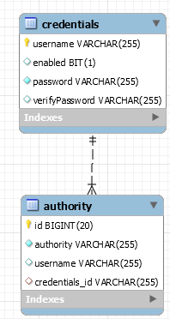
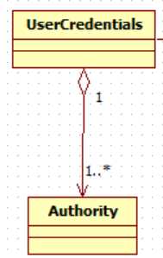
OneToMany Unidirectional JoinColumn
@Entity
public class Credentials {
@Id
private long id; ...
@OneToMany
@JoinColumn(name="credentials_id")
private List<Authority> authorities; ...
}
DEMO OneToManyUniCol
HIBERNATE REFERENCE DOC:
A unidirectional one-to-many association on a foreign key is an unusual case, and is not recommended. You should instead use a join table for this kind of association.
Notes:
https://stackoverflow.com/questions/25379046/why-hibernate-generates-insert-and-update-for-onetomany-mapping
INSERT then UPDATE children during UNIDIRECTIONAL
If you take a look at Hibernate flush order, you’ll see that the persist action is executed before the collection elements are handled. This way, Hibernate inserts the child records first without the Foreign Key since the child entity does not “OWN” this information. During collection handling phase, the Foreign Key column is updated accordingly.
NO UPDATE IF BIDIRECTIONAL since CHILD owns the relationship
https://vladmihalcea.com/the-best-way-to-map-a-onetomany-association-with-jpa-and-hibernate/
my book, many times, you are better off replacing collections with a query, which is much more flexible in terms of fetching performance.

Slide 19
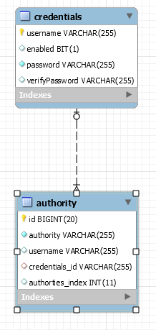
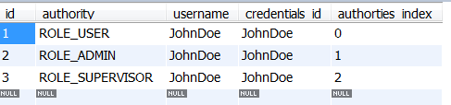
Indexed List
By Default LIST is NOT ordered in Database.
To create an Indexed List
@OrderColumn - put index field in target[Child/Many] table ….
@OneToMany(fetch = FetchType.EAGER, cascade = CascadeType.ALL)
@JoinColumn(name="credentials_id")
@OrderColumn(name = "authorties_index")
List<Authority> authority = new ArrayList();
DEMO OneToManyUniCol
NOTE the # of updates for Orphan Removal
Notes:
From OneToManyUniCol
SELECT o FROM Order o JOIN o.items i WHERE i.id = 1234 AND INDEX(i) = 0 From the JPA 2.0 specification (4.6.17.2.2 Arithmetic Functions):
The INDEX function returns an integer value corresponding to the position of its argument in an ordered list. The INDEX function can only be applied to identification variables denoting types for which an order column has been specified.

Slide 20
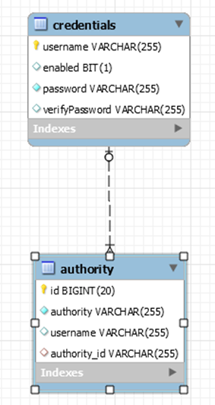
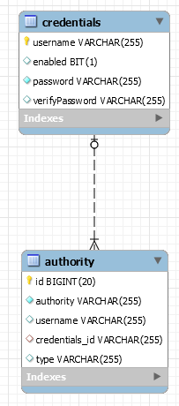

Map
By Default MAP is NOT ordered in Database.
To create an Map
@MapKey – uses existing field in target[Child/Many] table ….
@MapKeyColumn – creates column in target[Child/Many] table ….
@OneToMany(fetch = FetchType.EAGER, cascade = CascadeType.ALL)
@JoinColumn(name="credentials_id")
@MapKeyColumn(name = “type")
Map<Authority> authority = new HashMap();
DEMO OneToManyUniMap
See demo for query by KEY()
Notes:
@Key uses primary key
@MapKeyColumn if the map key is a basic type. If you don't specify the column name, the name of the property followed by underscore followed by KEY is used (for example orders_KEY).
@MapKeyEnumerated / @MapKeyTemporal if the map key type is respectively an enum or a Date.
@MapKeyJoinColumn/@MapKeyJoinColumns if the map key type is another entity.
Query query = session.createQuery("from Credentials c
where c.authorities['admin'].authority = ‘ROLE_ADMIN'");
@MapKeyColumn(name="name", nullable=true)
To map a map using a separate key column, in other words a key value that is not yet part of the other entity class, you have to use the @org.hibernate.annotations.MapKey annotation extension.
This creates the same mapping problems as with Lists, the collection side will need to become the owning side of the collection again. You can do this by adding @JoinColumn annotations to both sides of the association. On the Person class to stop it from creating a join table, and on the Pet class to tell it that it should not insert or update the association (emulate mappedBy)
Relation r = em.createQuery("select r from Relation r join r.langMap m where ( KEY(m) = :locale and VALUE(m) = :value ) " , Relation.class) .setParameter("locale" , locale) .setParameter("value" , value) .getSingleResult();
SELECT r FROM Relation r JOIN r.langMap map WHERE map[:locale] = :value

Slide 21
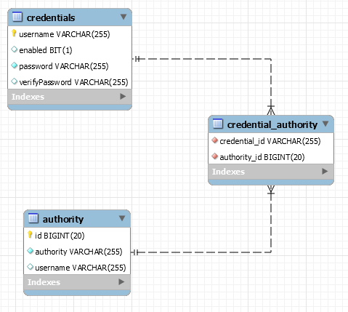

OneToMany Unidirectional JoinTable
@Entity public class Credentials{
@Id
private long id; ...
@OneToMany
private Set<Authority> authorities;
DEMO OneToManyUniTable

Slide 22
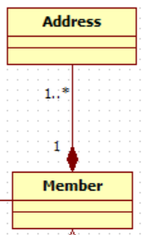
OneToMany Bi-directional JoinColumn
@Entity
public class Member {
@Id
@Column(name="member_id")
private Long id; ...
@OneToMany(mappedBy="member)
private List<Address> addresses;
}
NOTE: JoinColumn OPTIONAL
Bidirectional DEFAULTS to Join Column
DEMO OneToManyBiCol
@Entity
public class Address {
@Id
private Long id;
@ManyToOne(fetch=FetchType.EAGER)
@JoinColumn (name="member_id")
private Member member;}
Owns relationship
Notes:
To map a bidirectional one to many, with the one-to-many side as the owning side, you have to remove the mappedBy element and set the many to one @JoinColumn as insertable and updatable to false. This solution is not optimized and will produce additional UPDATE statements.
remove JUST the mappedBy element & you get a JOIN TABLE

Slide 23
OneToMany Bidirectional JoinTable
@Entity
public class Member {
@Id
private long id;
@OneToMany (mappedBy="member")
private List<Address> addresses;
}
DEMO OneToManyBiTable
OneToMany side same as unidirectional example only add mappedBy
Simply Add ManyToOne on child object PLUS
Identify JoinTable by Name
@Entity
public class Address {
…
@ManyToOne
@JoinTable ( name="Address_Member")
private Member member;

Slide 24
Bidirectional JoinTable
@Entity
public class Address{
@Id
private long id;
@ManyToOne(fetch=FetchType.EAGER, cascade = {CascadeType.PERSIST})
@JoinTable(name="AddressMember",joinColumns={@JoinColumn(name="ADDRESS)},
inverseJoinColumns={ @JoinColumn(name="Member")} )
private Member member;
Explicitly naming the Join Table & Columns
inverseJoinColumns identifies “opposite” or member side
Notes:
If the association is bidirectional, one side has to be the owner and one side has to be the inverse end (ie. it will be ignored when updating the relationship values in the association table):

Slide 25

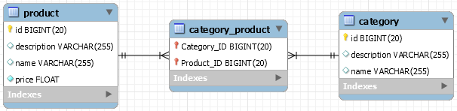
Many-To-Many Unidirectional
@Entity
public class Category{
@Id
private long id;
@ManyToMany
private Set<Product> products;
_______________________________________________
@ManyToMany(fetch = FetchType.EAGER, cascade = CascadeType.ALL)
@JoinTable ( name="Category_Product",
joinColumns={@JoinColumn(name="Category_ID")},
inverseJoinColumns={ @JoinColumn(name="Product_ID")} )
Set<Product> products = new HashSet<Product>();
NOTE: If Converting from OneToMany Join Table – simply drop the unique constraint on the JoinTable created by OneToMany in the Database
DEMO ManyToManyUni
Explicitly named JoinTable:
Similar to OneToMany – Explicitly naming the Join Table & Columns

Slide 26
Many-To-Many Bidirectional
@Entity
public class Product {
@Id
private long id;
@ManyToMany(fetch=FetchType.EAGER,cascade={CascadeType.MERGE},mappedBy="products")
private List<Category> categories = new ArrayList<Category>();
DEMO ManyToManyBi
Add Category reference to Product
To make it bidirectional
one direction must be defined as the owner and the other must use the mappedBy attribute to define its mapping.
OTHERWISE
There will be two independent relationships, duplicate rows will be
inserted into the join table

Slide 27
SET BOTH SIDES of a Bidirectional Relationship
You can end up saving one side without ever setting the foreign key in the “OWNER” side [OneToMany,OneToOne]
In a ManyToMany the side referred to by the mappedBy attribute, is the owner of the relationship. BUT there is no foreign key so what does that mean ??!!??
It Means:
Good Practice: Always encapsulate setting both sides….with a
convenience method…
DEMO EXAMPLES: OneToManyBiCol [Member]
ManyToManyBi [Product]

Slide 28
Bidirectional Considerations
Domain Driven Design:
Reduce complexity by identifying a traversal direction ** (RE: avoid bidirectional associations if possible)
Removes coupling in domain model
Simplifies code in domain model
Removes circular dependencies
** Traversing the other direction is still possible by querying the underlying persistence system.
See demo OneToManyBiAsUni

Slide 29
Inheritance
  Single Table
  Contains all columns for Super Class & ALL Sub Classes. De-normalized schema. Efficient queries. Difficult to maintain as the number of columns increase.
  Joined Tables [Table Per Subclass]
  Normalized schema. Less efficient queries.
  Effective if hierarchy isn't too deep.
  Table per Class
  Super Class is replicated in each subclass table.
  JPA - Optional
Notes:
https://en.wikibooks.org/wiki/Java_Persistence/Inheritance
Table per class
Be cautious using this strategy as it is optional in the JPA spec, and querying root or branch classes can be very difficult and inefficient.
The distinction is apparent when querying the base class, which will return all the sub-class records as well by using a UNION statement in the background.
The use of UNION can also lead to inferior performance when choosing this strategy. Another issue is that we can no longer use identity key generation.
@MappedSuperclass - Mapped superclasses can’t be targets of entity relationships only good for properties [AND superclass NOT an ENTITY]

Slide 30
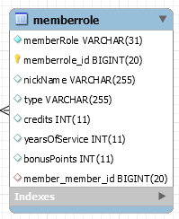
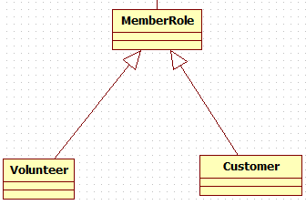
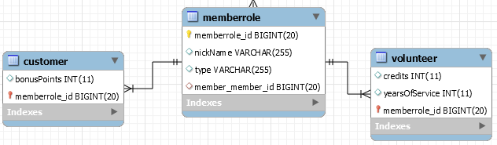
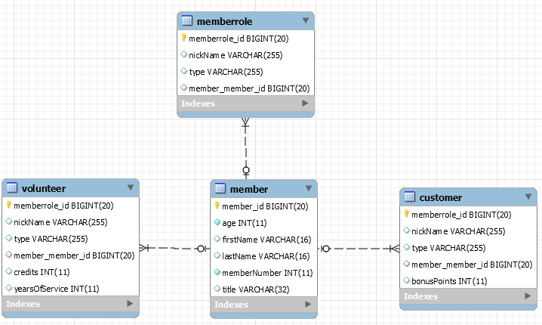
Three ways to map
Legend
Blue=MemberRole
Red=Volunteer
Green=Customer
You can map inheritance in one of three ways:
  Single Table [per Hierarchy]
    De-normalized schema
    Fast polymorphic queries
  DEMO Singletable
  Joined Tables
    Normalized & similar to OO classes
    Slower queries
    **Good if following GoF Patterns**
  DEMO TablePerSubClass
  Table per [Concrete] Class
    Uses UNION instead of JOIN
    All needed columns in each table
    DEMO TablePerClass
Notes:
You can map OO inheritance onto a relational schema in one of three ways:
Single Table per Hierarchy:
Has a de-normalized schema, subclass properties have to be nullable
Very fast performance for polymorphic queries
Joined Tables:
Has a normalized schema that is very similar to how the properties are found in the OO classes
Is slower on queries due to the necessity of JOINs
Table per Concrete Class
Uses UNION operations to perform polymorphic queries (instead of the JOINs used by Joined Tables)
All of the needed columns are found in each table.
Union makes two queries look like one. Joins are for examining two or more tables in a single query statement
A Join allows you to relate similar data in different tables.
A Union returns the results of two different queries as a single recordset.
This strategy does not support the IDENTITY generator strategy: the id has to be shared across several tables.

Slide 31
Mapping for Single Table
  Single Table [per Hierarchy]
  De-normalized schema
    Fast polymorphic queries
  DEMO SingleTable

Slide 32
Mapping for Table Per SubClass
  Implemented by Joining Tables
    Normalized & similar to OO classes
    Slower queries
    **Good if following GoF Patterns**
  DEMO TablePerSubClass

Slide 33
Mapping for Table Per Class
  Table per [Concrete] Class
    Uses UNION instead of JOIN
    All needed columns in each table
    DEMO TablePerClass
Notes:
Table Per class needs hibernate generation type TABLE
WHEN using hibernate generation type TABLE eacore.hibernate_sequences table is created
It has entry [column sequence_name= MemberRole in our case ] for the superclass.
It increments the colmn sequence_next_hi_value – for every MemberRole [ in our case we have ONE MemberRole]
The UNION operator is used to combine the result-set of two or more SELECT statements.
Each SELECT statement within UNION must have the same number of columns
The columns must also have similar data types
The columns in each SELECT statement must also be in the same order

Slide 34
Miscellanea
Shared Primary Key
USE CASE: OneToOne where table is split into two tables
resulting into same primary key
Composite key
USE CASE: Legacy database : database key is
comprised of several columns
@SecondaryTable
USE CASE: Legacy database entity data stored in
multiple tables
@Embeddable/Embedded
USE CASE: Legacy database HUGE table with “logically”
separate columns [ e.g. Address inside Customer]
Notes:
Shared PK example is TABLEPERSUBCLASS
1 – 0…*
Nullable columns are generally frowned upon since they break normalization
To avoid nullable foreign key columns on optional associations you can use
a join table for an optional many to one associations :
JPA does not support a shared PK OneToOne
This mapping results in a ManyToOne with a Unique Constraint (Therefore OneToOne)
Shared primary key workaround SEE MZ Associations Slide 29
@PrimaryKeyJoinColumn
Such associations Shared PK are used when a single table is split into two tables resulting into same primary key. For e.g. Customer and CustomerDetails entities. We create such association only when we are sure that the child entity is Created/Persisted/Removed only when the parent is Created/Persisted/Removed.

Slide 35
Main Point
Entities and objects relationships can be established through the different types of associations, creating a rich foundation that can represent a real world domain.
Science of Consciousness: Seek the highest first, start with a good foundation and build rich relationships upon it.

Slide 36
Enumerations
Using the Hibernate @Enumerated annotation
Use EnumType.ORDINAL or EnumType.STRING to map the
enum value to its database representation either as order number OR name.
It Has weaknesses
@Enumerated(EnumType.ORDINAL) store order number
ISSUE: Removing or adding enum value in the middle or rearranging them
will break existing records.
@Enumerated(EnumType.STRING) stores enum name
ISSUE: Renaming an enum value will break existing records
SOLUTION: JPA Converter
Provides custom conversion from Java representation to database
Use an “Alias” representation of the enum values in the database
@Converter (autoapply=true ) - convert all entity attributes of the given type.
public class ProductionStatusConverter implements
AttributeConverter<ProductionStatus, String> {
See ManyToManyUni Demo

